Slide 1
Forward-Forward Algorithm revisited
334 – Buciu Theodor
334 – Manole Catalin
334 – Ioan Alexandru

Slide 2
Introduction
FFA is trying to be more biologically plausible and as a side effect more efficient for certain hardware configurations such as analog hardware.
The algorithm revolves around local update rules based on a goodness score calculated as the p(positive) = σ(Sum(yl^2) − θ) where θ is the hyper-parameter threshold and yl are the activations of the layer l thus localizing the loss calculation and update on each individual layer thus parallelizing the training process.

Slide 3
Approach
We are building our neural networks in Pytorch, testing the performance of both a Forward-Forward trained model and two traditionally trained models for each task.
Hardware configurations:
  i3-10100F + gtx 1050ti
  i7 14650-hx + rtx 4060M
  i7-10750H + gtx 1650ti
  (we will specify the hardware used for each experiment as to not confuse them)

Slide 4
Approach
We will test and compare FFA results to the other models by looking at the following metrics:
• Train time
• Number of epochs
• Accuracy
• Memory usage on similar performance
• Overfit and underfit tendencies

Slide 5
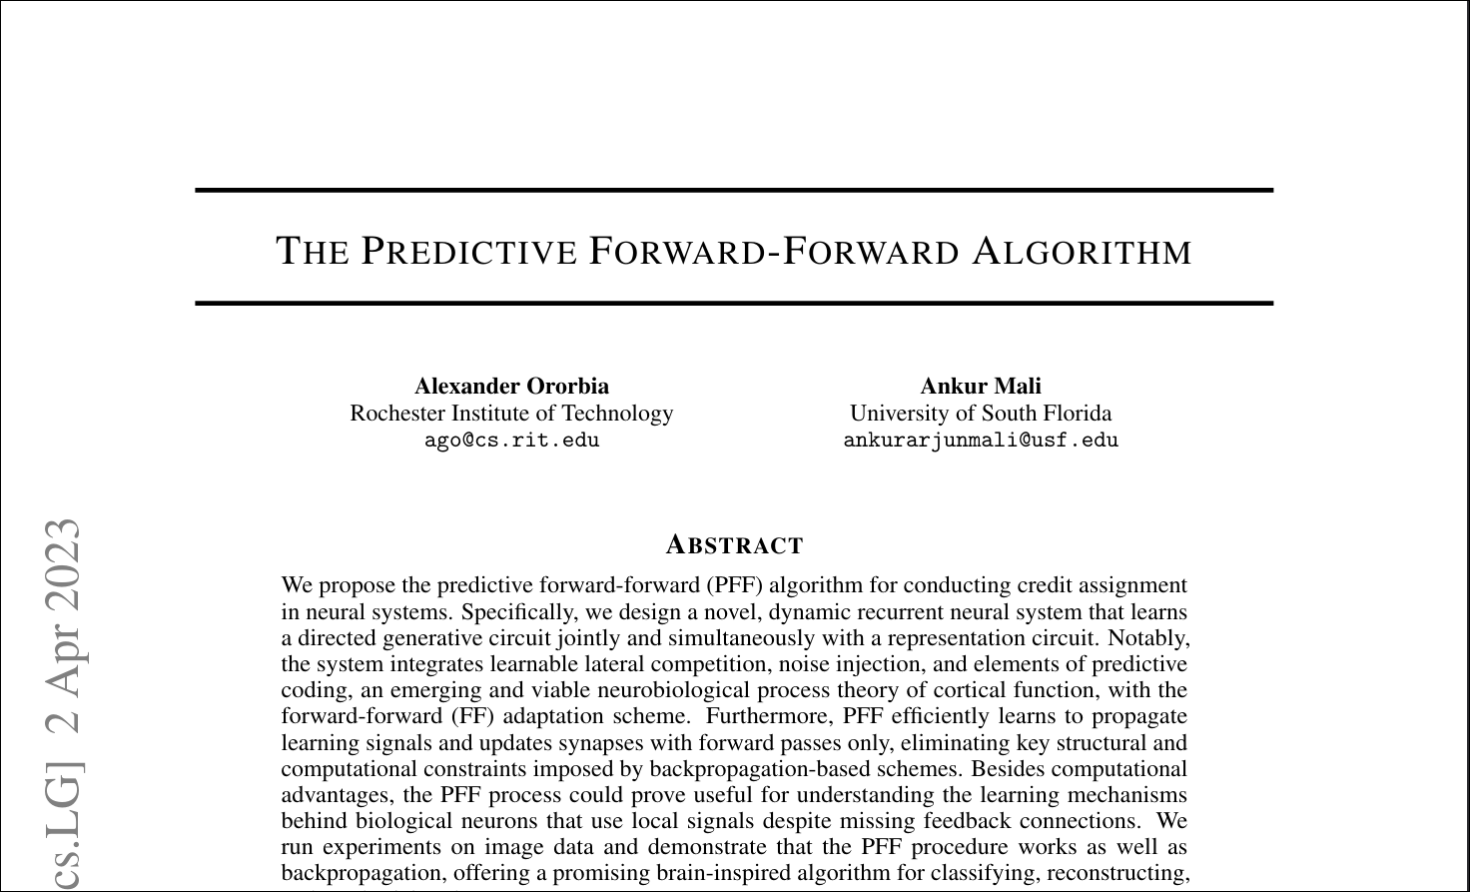

Slide 6
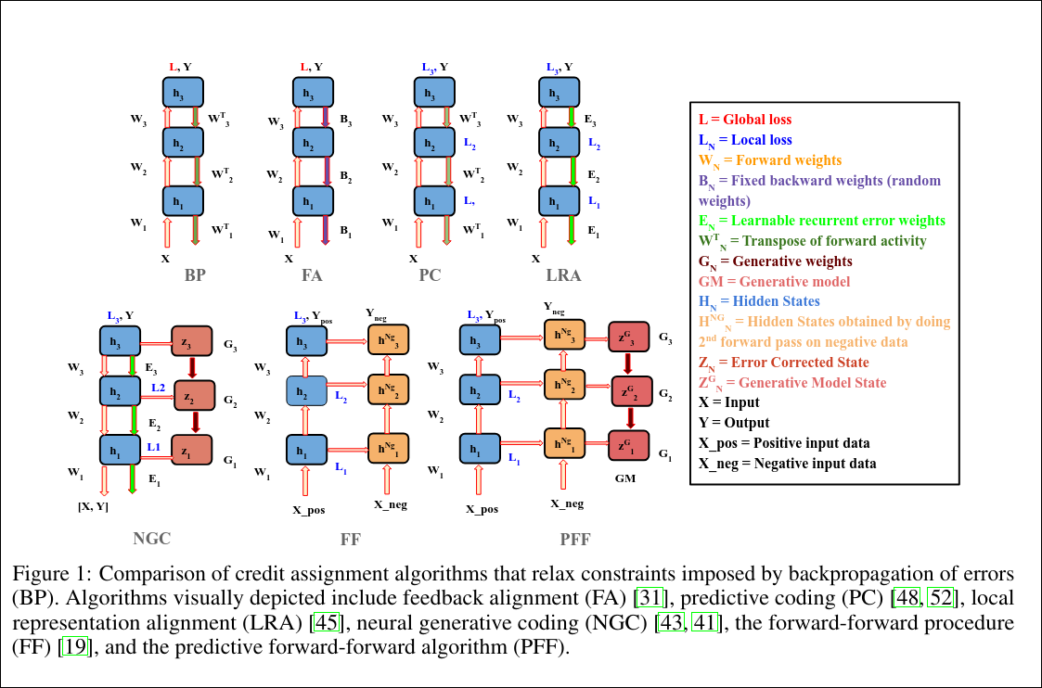

Slide 7
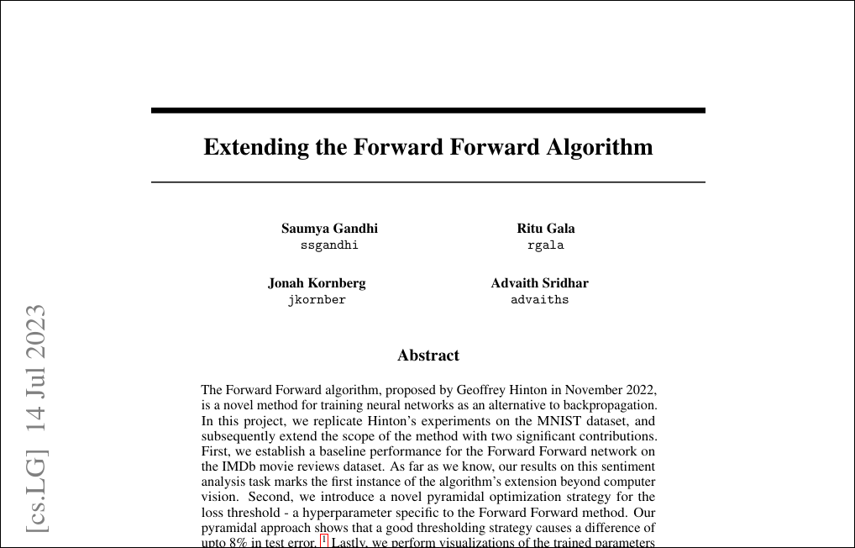

Slide 8
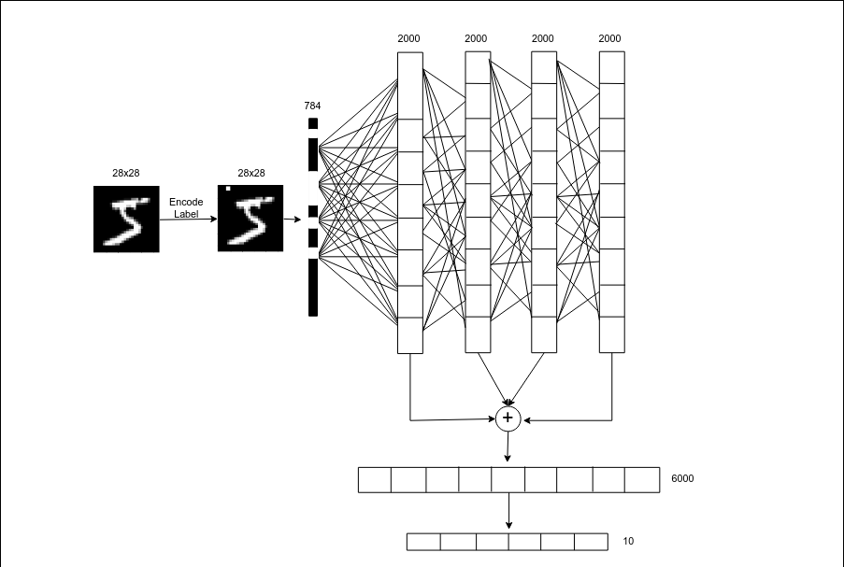

Slide 9
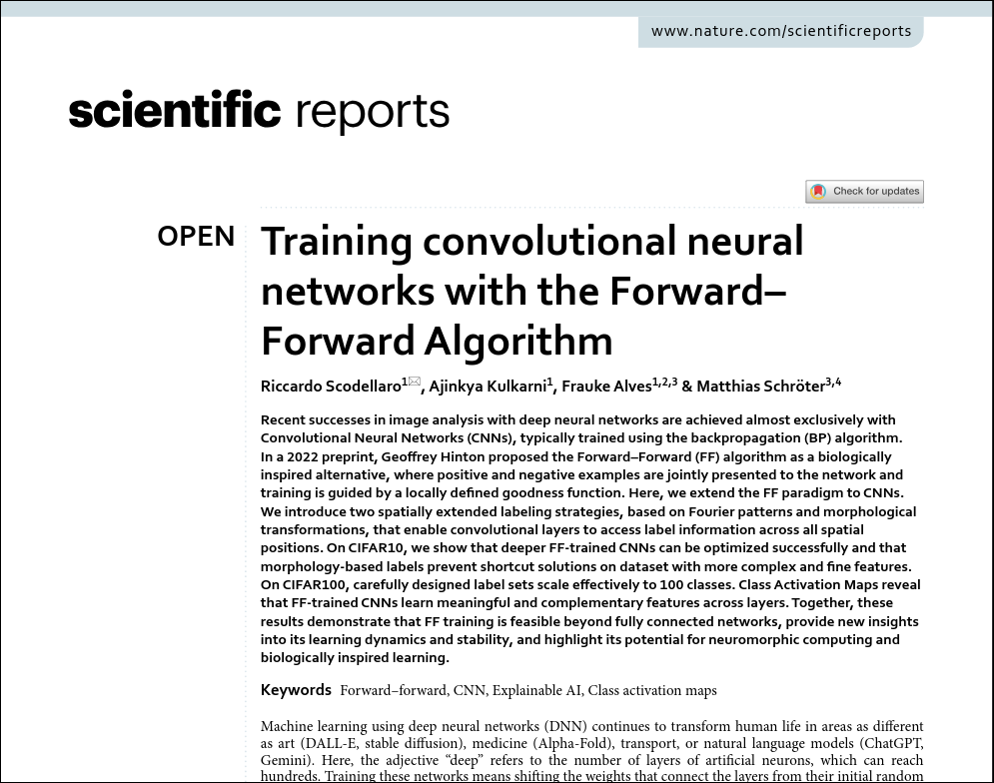

Slide 10
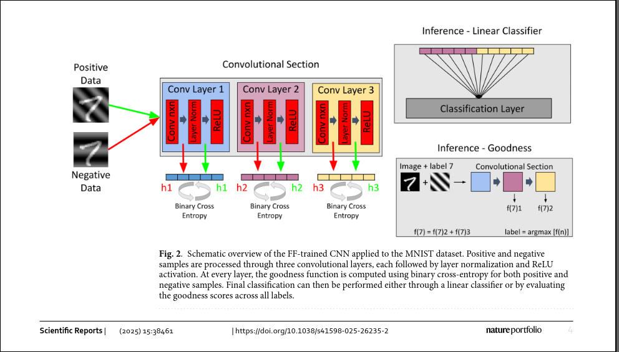

Slide 11
Task 1: XOR
This is just a validation problem proving that FFA can solve this problem as well as showing difference in the ration of neurons necessary to solve it.

Slide 12
Task 2: MNIST
The MNIST dataset is composed of 70,000, label 28x28 images of grayscale handwritten digits that is used to benchmark image classification algorithms.
For this test we are going to write a FFA MLP network as well as the 2 corresponding MLP backprop networks, and try our hands at a FFA CNN and it’s comparison networks .

Slide 13
Task 3: IMDB Reviews
The IMDB Reviews dataset consists of 50K tagged movie reviews, the tag can be positive or negative. In this case we are to preprocess the text and using the model word2vec to get the embeddings for the model.
Now as for the architecture of the model we are going to use a MLP and it’s corresponding backprop models. Here we have the chance to compare the results of this model with a basic RNN or LSTM, these being architectures that are normally impossible to train using FFA.

Slide 14
Task 4: Sherlock Holmes Next-Word Prediction Corpus
?

Slide 15
Limitations
The main limitations to Forward-Forward Algorithm:
- difficult to create Deep Neural Networks
- fails on large datasets or complex tasks
- highly dependent on negative data

Slide 16
Articole
Geoffrey Hinton. 2023. The forward-forward algorithm:
https://www.cs.toronto.edu/~hinton/FFA13.pdf
Alexander Ororbia, Ankur Mali, and Dan Roth. 2023. (The Predictive Forward-Forward Algorithm):
https://arxiv.org/abs/2301.01452
Jonah Kornberg, David W. Brown, and Benjamin A. Cohen. 2023. (Extending the Forward Forward Algorithm):
https://arxiv.org/abs/2307.04205
Training convolutional neural networks with the Forward–Forward Algorithm:
https://www.nature.com/articles/s41598-025-26235-2.pdf

